Slide 1
Commander Directed Investigation
(CDI)
Capt S. Daniel Colton

Slide 2
Overview
CDI Guide
Authority
Appropriate Issues for a CDI
CDI Procedure
Evidence Collection and Witness Issues
Post-Investigation Process
Standard of Proof
Post-Report Process
Releasability of CDIs

Slide 3
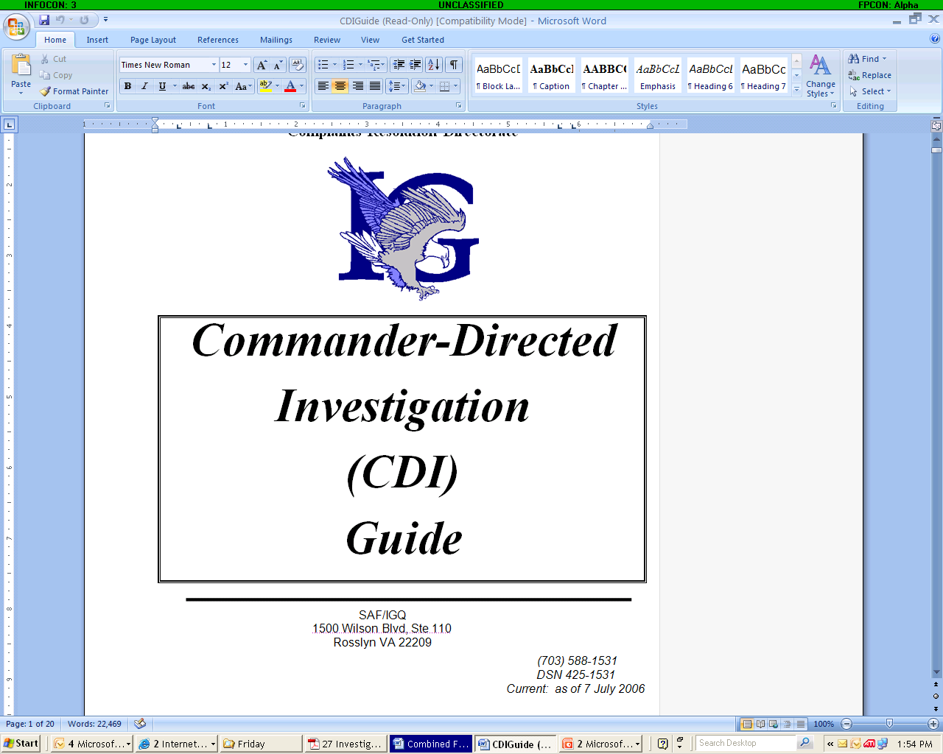
CDI Guide

Slide 4
Authority: Authority is inherent in the command
  Squadron CC (or civilian equivalent) level or above (on G-Series orders)
  Authority is based upon military custom to direct an investigation within their command unless preempted by a higher authority
CC’s should consult the SJA before initiating a CDI
  JA will assist in drafting Investigating Officer (IO) appointment letter with framed allegations
  JA will provide a legal advisor to the IO

Slide 5
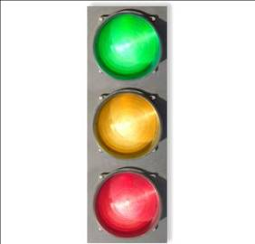
Appropriate Issues for CDIs
  YES - Command matters
    Abuse of authority within the command
      Arbitrary and capricious exercise of power for personal gain or adversely affects the rights of any person
    Systemic (or procedural) matters
  MAYBE – Fraud, waste and abuse; UCMJ offenses; Equal Opportunity (EO) issues
  NO – Issues covered by an appeal or grievance process; IG “big three” (reprisal, restriction, improper MHE referral); Senior Official misconduct; Sexual assault, Domestic abuse

Slide 6
Procedure
CC Initiates the CDI by appointing an IO in writing
    Contact JA for assistance drafting appointment letter and framed allegations
    IO should be equal or senior in grade and not in subject’s chain of command (generally ≥ senior Capt or senior NCO)
CC Provides the IO
    Appointment letter
    Framed allegations
    Copies of relevant materials
    Administrative support (workspace, computers, copying, technical assistant, etc.)
    Subject Matter Expert if necessary (e.g. EO
    Access to witnesses and documents
    Oversight

Slide 7
Procedure – IO Responsibilities
Gathers all necessary facts and evidence
Stays on task by investigating only the items outlined by the commander
  If new issues come to light, IO has a duty to notify the CC
  CC decides how additional issues will be treated
Consults with legal advisor as necessary
Remains professional
  Objective, neutral and fair
  Friendly but not familiar
  Should not disclose witness identities or opinions
  Should not deceive, threaten, coerce or make promises

Slide 8
IO Evidence Collection
Evidence can be testimonial (under oath), physical, or circumstantial (observations based on the circumstances)
Rights Advisement
  Not Automatic – Usually only if the individual is suspected of having committed an offense
    Usually the subject of the CDI, rarely the other witnesses
  Military – Article 31 rights advisement
  Civilian – Fifth Amendment if Custodial Interrogation
  Special issues may arise if interviewing Labor Union members
Testimonial evidence should be memorialized preferably via AF Form 1168 or an IO summary
Notes:
Employees also have the right, during an investigatory interview conducted by a representative of the Air Force, where the employee reasonably believes discipline may occur as a result, to request the presence of a representative from the labor organization that represents the bargaining unit to which the employee belongs (“Weingarten” rights). To exercise this right, the employee must request representation. There is no duty for the IO to advise the employee of this right. When this right is invoked, the IO may wait until a representative from the labor organization arrives or inform the witness that if a representative is desired, no interview will take place, and the case will proceed without any input from the witness. The role of the representative is much greater here. The representative is a personal representative of the employee and may provide advice, consult with the witness, and suggest areas of inquiry, but may not obstruct the interview or instruct the witness not to answer legitimate questions. The situation can occur where both the rights of a labor organization and the rights of an employee arise and could result in two representatives from the labor organization.

Slide 9
Witnesses
Military – CC may order to testify
DoD Civilians – CC may direct to testify
Civilians – Cannot be ordered/directed to testify
  Includes contractors, NAF employees, dependents, etc.
Retirees – Cannot be ordered/directed to testify unless recalled to active duty
Minors – Same as civilians
  Parental consent will likely be required
ANG/Reserve Personnel – Same as civilians unless placed on active duty orders

Slide 10
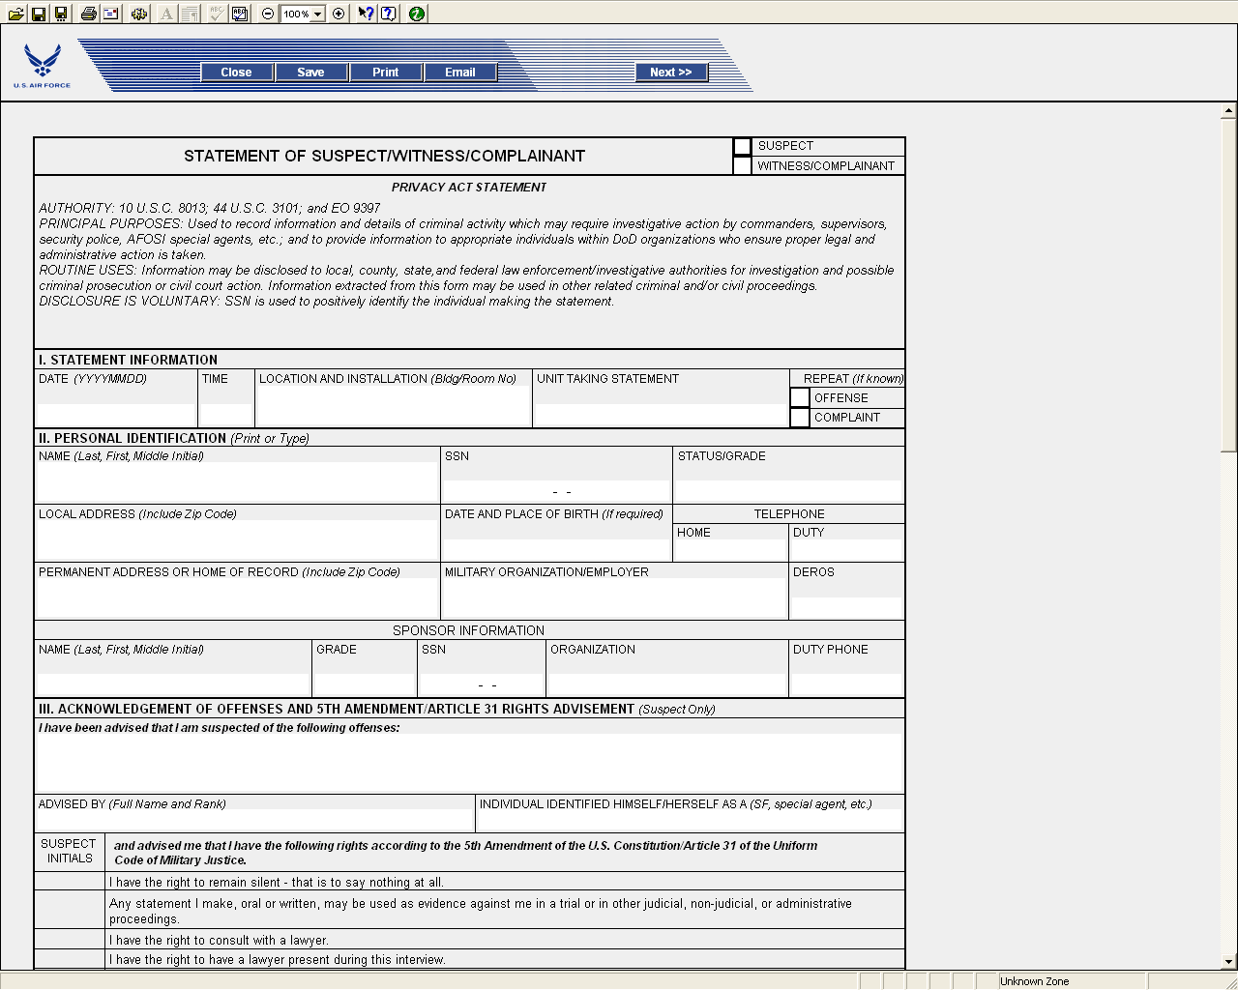
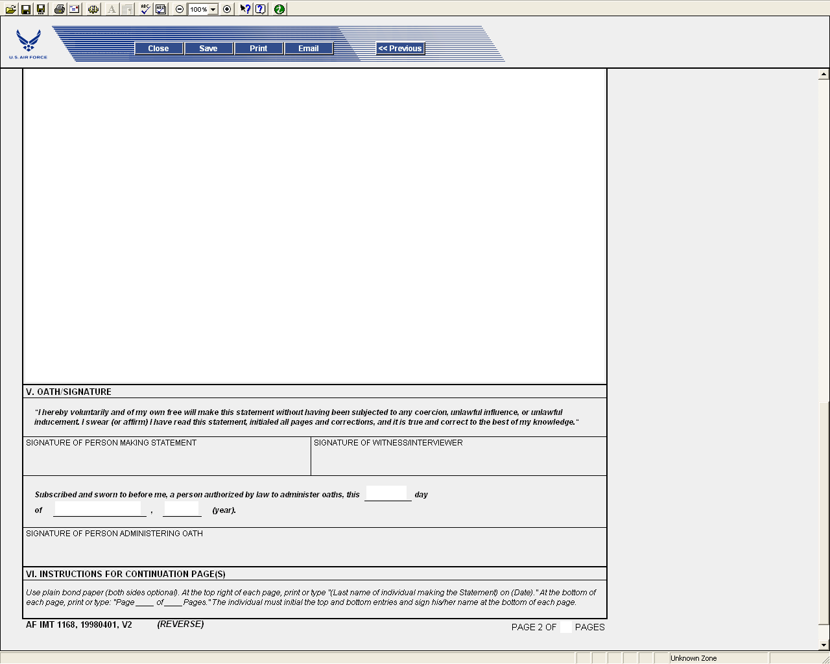
AF Form 1168

Slide 11
Post-Investigation Process
IO prepares final report
CDI Guide provides suggested format to include:
  Appointment letter
  Authority and scope
  Background and Allegation(s)
  Findings, Analysis & Conclusion
  Recommendations (if requested by the appointing CC)
  Testimonies of witnesses
Once completed IO should submit to JA for legal sufficiency review

Slide 12
CDI Standard of Proof
Standard – Preponderance of the Evidence
  Just more likely than not!
  Not a beyond a reasonable doubt standard
Factors to consider when weighing evidence
  Witness demeanor
  Opportunity or knowledge
  Bias
  Motive
  Intent and ability to recall and relate events

Slide 13
Post-Report Actions
Final notification of CDI results is exclusively the CC’s prerogative
Information obtained may be used in any administrative action against subject or other individual – Consult JA first
No formal appeal – w/in discretion of the initiating CC and the next echelon of command

Slide 14
Can a CDI be released
CC is release authority for CDIs
  Generally limit access – “Need to know”
  May not be released, reproduced or disseminated w/out express permission of the initiating CC.
  Coordinate any release of information with JA
  Forward any FOIA requests to the FOIA office for coordination
  IF CDI involves an O-6 – provide a copy of all pertinent documents to SAF/IGQ through the base OG office
PRIVACY ACT APPLIES!!!

Slide 15
Inspector General Investigations

Slide 16
Inspector General Authority
AFI 90-301
    Complainants have a right to file an IG complaint at any level without going through their supervisory chain
    10 U.S.C. 8020: The IG shall inquire into and report upon discipline, efficiency, and economy of the AF
      Fraud waste & abuse
      Reprisal
      Improper mental health referrals
      Blatant favoritism
      Abuse of authority
    Not criminal
    See Table 2.5.

Slide 17
Authority to Direct and Conduct Investigations, AFI 90-301
  Each investigation is completed in writing by a designated appointing authority
  Only appointed IG investigating officers are authorized to conduct IG investigations
    Can only investigate matters within the scope of their appointment
Who can be an IO?
  A field grade officer, senior NCO, or AF civilian with a substantial breadth of experience, exceptional maturity, and demonstrated sound judgment

Slide 18
General Procedures
AFI 90-301
Complaint resolution:
  Dismissal, Referral, Transfer to another IG, Investigate
Investigation Steps (Investigation of an 0-5 and below):
  Single officer (“IO”) appointed in writing
    Gather documents, interview witnesses, analyze the evidence, write an investigation report
  Notify subject’s CC in writing of scope of investigation
  CC notifies subject in writing
  CC notifies witnesses
  IG notifies Complainant
  IG documents the case as an “Investigation”

Slide 19
What does the JAG do?
JAG’s role
  Analyze complaints to ID allegations of wrongdoing
  Advise on framing allegations
  Advise and assist IOs
    Sworn testimony – All witnesses must be sworn (Para 2.42.2)
    Rights advisements (Para 2.45 & SAF/IGQ 14 Feb 05 memo)
    Investigation plan
  Para 2.59 & OpJAGAF 1998/109: Provide a legal review of IG Reports of Investigation
    Should be a different JAG than the JAG advisor
    Review for legal sufficiency

Slide 20
  Standard of Proof
  AFI 90-301, Para. 2.48
  Inspector General investigations:
  “Preponderance of the Evidence”

Slide 21
Privilege
AFI 90-301, Para. 2.3 & Chapt. 13
Limited Privilege, not released except for --
  Official use (DoD “need to know”)
  Required by law, i.e.,
    Discovery requests
    Privacy Act applies
    FOIA, unless an exemption applies:
      Usually redact information about third parties, complainant, etc under FOIA exemption 6.
      Redact anything “deliberative” under FOIA exemption 5
      Exemption 7, law enforcement
      Legal review, Exemption 5

Slide 22
Article 138 Complaints
MSgt Dean Lares

Slide 23
Article 138 Complaints
Article 138, UCMJ gives every member of the Armed Forces the right to complain that he/she was “wronged” by his/her commanding officer.
References: UCMJ Article 138, AFI 51-904

Slide 24
Article 138 Complaints
Scope: Matters appropriate to address include discretionary acts or omissions by a commander that adversely affect the member personally are:
  In violation of law or regulation
  Beyond the legitimate authority of that commander
  Arbitrary, capricious, or an abuse of discretion
  Clearly unfair, e.g. selective application of admin standards/actions

Slide 25
Article 138 Complaints
Outside scope:
  Acts or omissions affecting the member which were not initiated or ratified by the commander
  Disciplinary actions under the UCMJ
  Actions initiated against the member where governing directive requires final action by SecAF
  Complaints against GCMCA in relations to final resolution of Art 138 complaint, unless alleged GCMCA failed to forward a file copy to SecAF
  Complaints seeking disciplinary action against another
  Complaints based on commanders action implementing the recommendations of a board authorized by AF regulations and governed by AFI 51-602, Boards of Officers

Slide 26
Article 138 Complaints
Procedures:
  Within 180 days of alleged wrong, member submits written complaint (with supporting evidence) to commander alleged to have committed wrong
  Commander promptly notify complainant in writing whether redress is granted or denied
    State basis for denial
    Commander may consider additional evidence and must attach copy to file

Slide 27
Article 138 Complaints
Procedures continued:
  Member may submit complaint, along with commanders response to GCMCA over commander
  Must submit within 90 days from notice of denial
  May submit to GCMCA or forward to superior commissioned officer (can attach additional pertinent documentary evidence and comment on availability of witnesses or evidence, not on merits of complaint)

Slide 28
Article 138 Complaints
Procedures continued:
  GCMCA can conduct or direct further investigation of matter (Prohibited from delegating responsibilities)
  Notify complainant in writing of action taken and reasons for such action
  Refer complainant to appropriate channels that exists specifically to address alleged wrong
    EPRs, suspension from flying status
    Referral constitutes final action
  Retain two copies of file, return originals to complainant
  After final action forward a complete copy to HQ USAF/JAA for review and disposition by SecAF

Slide 29


Questions

